Slide 1
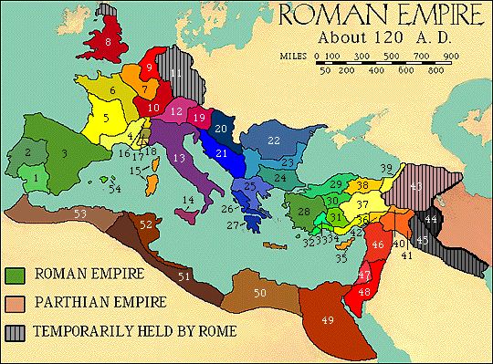
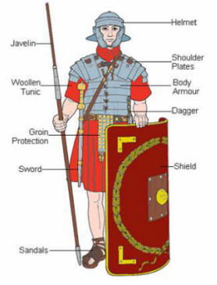
ANCIENT ROME

Slide 2
2,000 years ago…
Rome is the capital of the Roman Empire and rules the lands around the Mediterranean Sea.

Slide 3
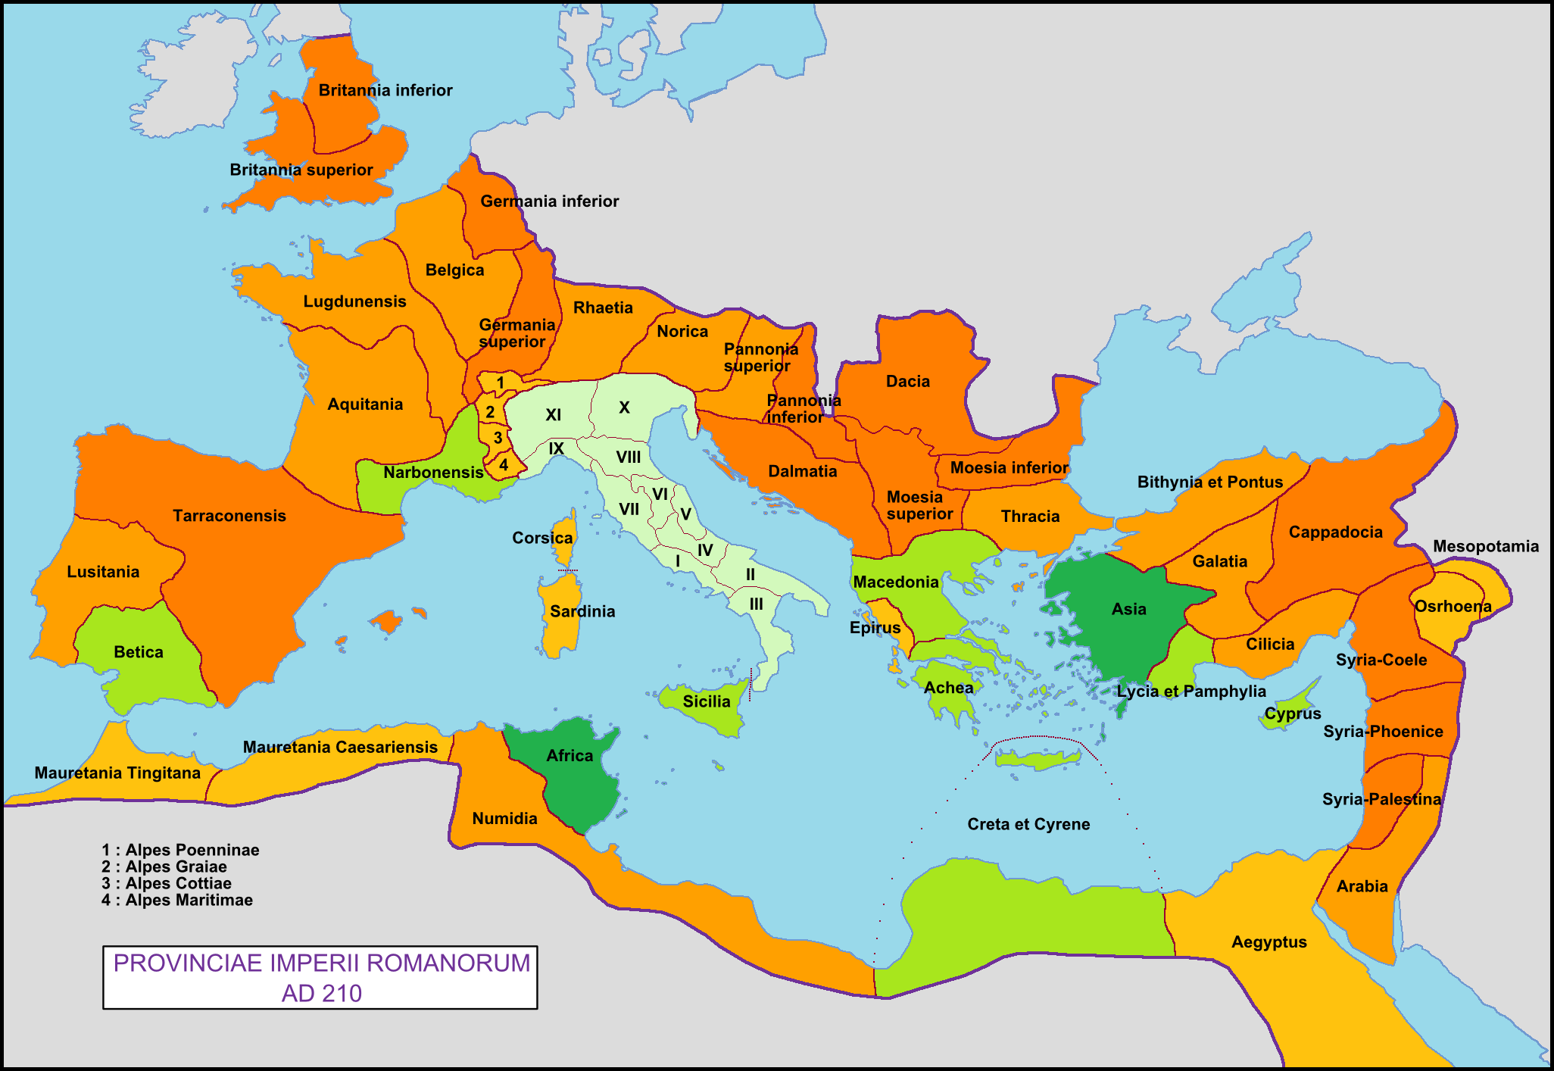
On this map, today we have…
Spain
France
Italy
Turkey
Greece
Egypt
England
North Africa

Slide 4
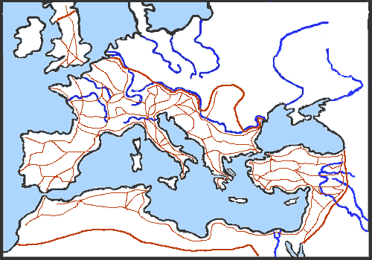
Roman roads
Roman soldiers build long, straight roads linking towns all over the Empire.

Slide 5
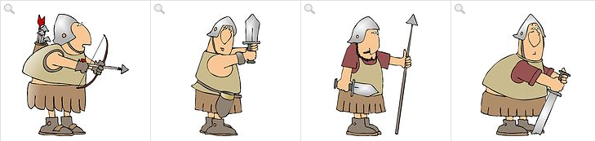
The roman army: well trained soldiers with,,,
An arrow
A dagger
A spear
A sword

Slide 6
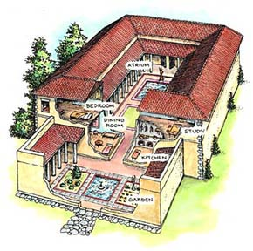
Houses in rome
Rich people live in comfortable houses with large gardens, toilets, water and central heating.

Slide 7
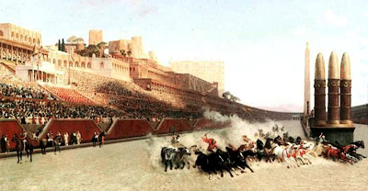
Roman pastimes 1
The Romans love chariot races. They take place at ahuge racetrack called “circus”

Slide 8
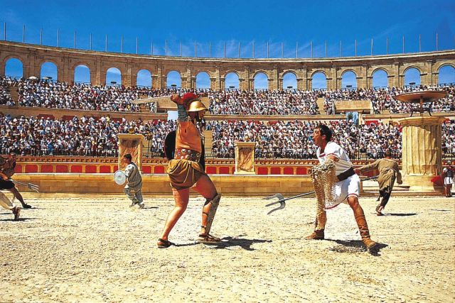
Roman pastimes 2
People like watching gladiators.
Gladiators often die in these brutal fights

Slide 9
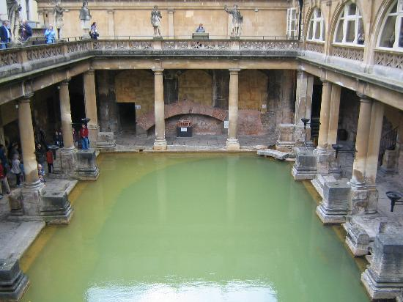
Roman pastimes 3
Most Romans go to the baths every day to relax, exercise, meet friends and to get themselves clean

